Slide 1

DAWG Workshop #1: 16S & ITS Amplicon Sequencing
Tree of Life Workshop Series

Slide 2
Workshop Objectives
Understand basics of 16S and ITS amplicon sequencing
Use the DADA2 pipeline for 16S and ITS amplicon data
Use FUNGuild for predictive functional analysis on ITS data

Slide 3
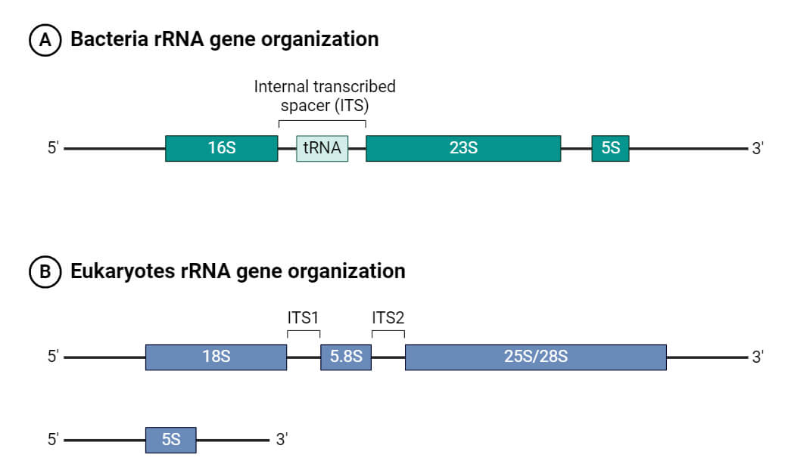
What is Amplicon Sequencing?
Used to identify bacteria and/or fungi present in a sample
Focuses on specific regions of DNA or RNA within a sample
Involves amplifying and sequencing a particular gene or genomic region of interest
Notes:
https://www.cd-genomics.com/resource-16s-18s-its-amplicon-sequencing.html

Slide 4

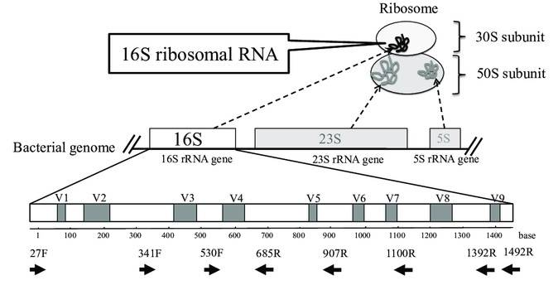
16S Amplicon Sequencing
16S rRNA gene region
Marker for identifying bacteria
Conserved regions
1500 bp in length
Variable regions
V1 - 9
The schema of ribosome complex and 16S rRNA gene (Fukuda et al. 2016)
Notes:
Conserved regions: Allow development of universal primers that can amplify and sequence a large range of bacterial taxa
Variable regions: Unique fingerprints that allow taxonomic identification
https://www.cd-genomics.com/resourse-principels-and-workflow-of-16s-18s-its-amplicon-sequencing.html

Slide 5

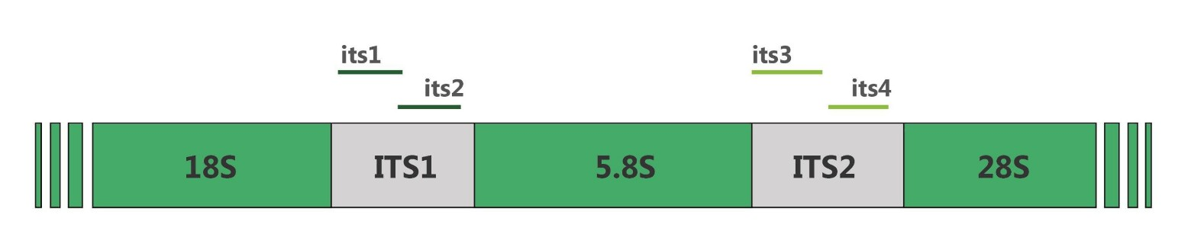
ITS Amplicon Sequencing
Internally Transcribed Spacer (ITS)
Marker for identifying fungal
Conserved regions
18S, 5.8S, 28S rRNA genes
Variable regions
ITS1 and ITS2
Notes:
https://www.cd-genomics.com/resourse-principels-and-workflow-of-16s-18s-its-amplicon-sequencing.html

Slide 6
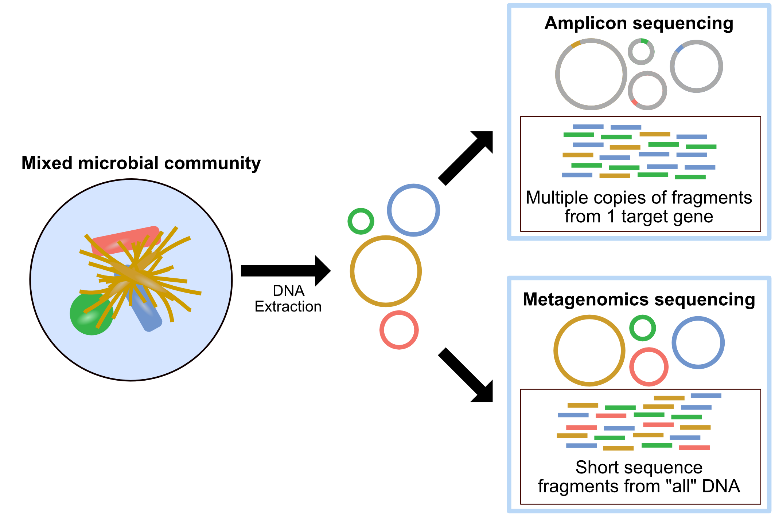
Amplicon vs. Metagenomics
Amplicon
Targets specific regions for sequencing
Metagenomics
Sequences entire genetic material present in a sample
“Who is there?”
“Who is there and what can they do?”

Slide 7
Advantages & Limitations
“Who is there?”
“Who is there and what can they do?”
Amplicon
Cost-effective
Genus-level
resolution
Limited
functional
information
Metagenomic
More expensive
Higher
taxonomic
resolution
Functional
information
Culture free methods
Community composition
Notes:
Amplicon sequencing is great for identifying community composition at genus or sometimes species level, but it doesn’t tell you about gene function directly.
Metagenomics can give you that functional insight, but it’s more expensive and complex to analyze."*

Slide 8


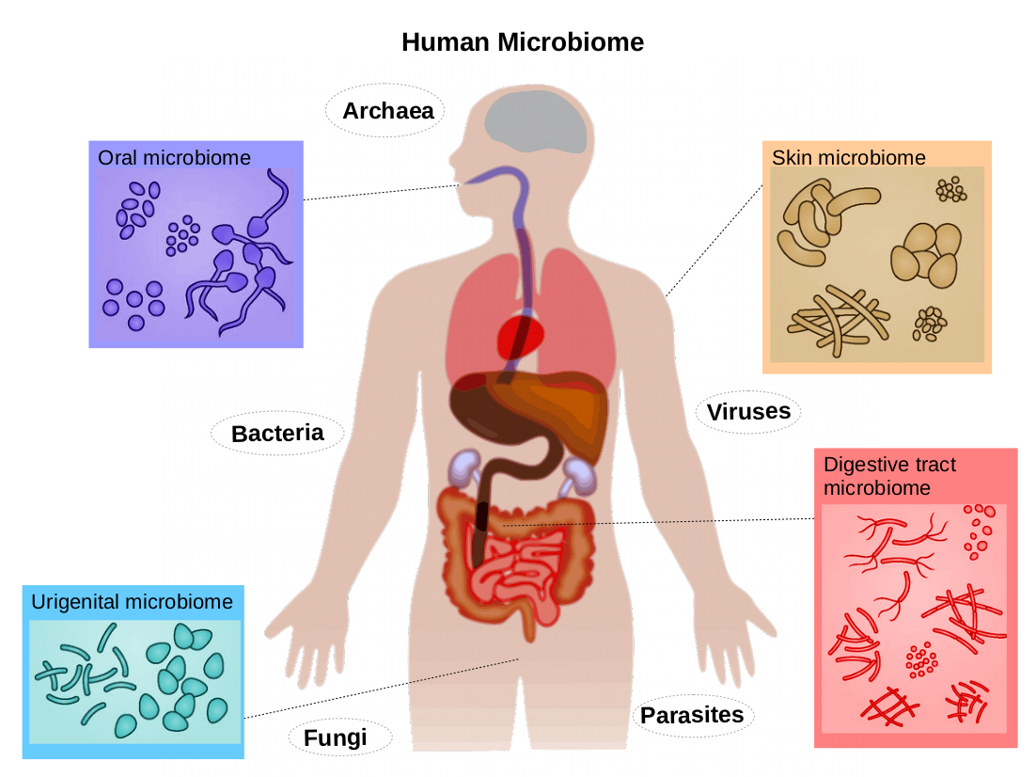
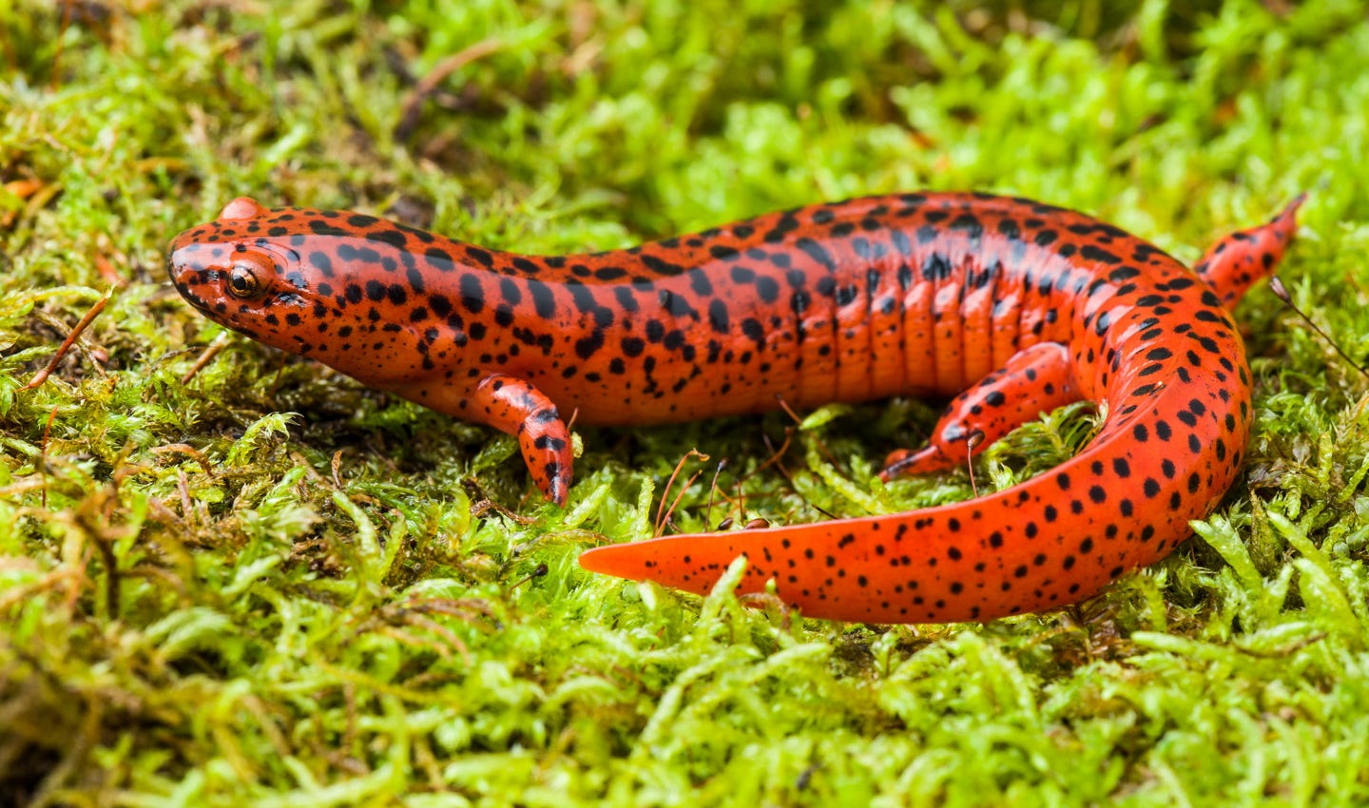
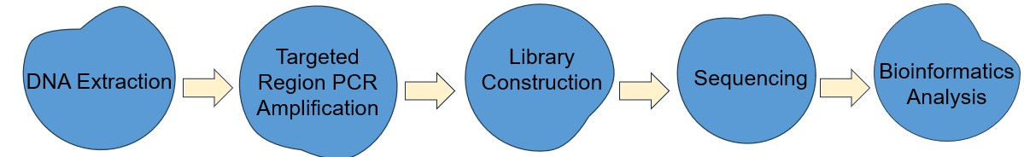
Amplicon Sequencing Workflow
Notes:
The general workflow follows these steps: extract DNA, amplify the target region, prepare your library for sequencing, run the sequencer, and then analyze the data

Slide 9
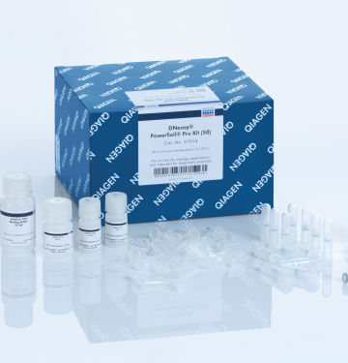
1) DNA Extraction
Goal: Isolate high-quality microbial DNA from a sample
Input: Biological/environmental sample containing microbial cells
Output: Purified total DNA suitable for downstream PCR
Notes:
The goal here is to isolate high-quality DNA from your sample. If you start with poor-quality DNA, everything downstream will be harder.
Good quality DNA is primarily defined by high purity, which means it lacks significant contaminants like proteins, phenols, or salts, and high integrity, indicating it has not been degraded or fragmented into small pieces.

Slide 10
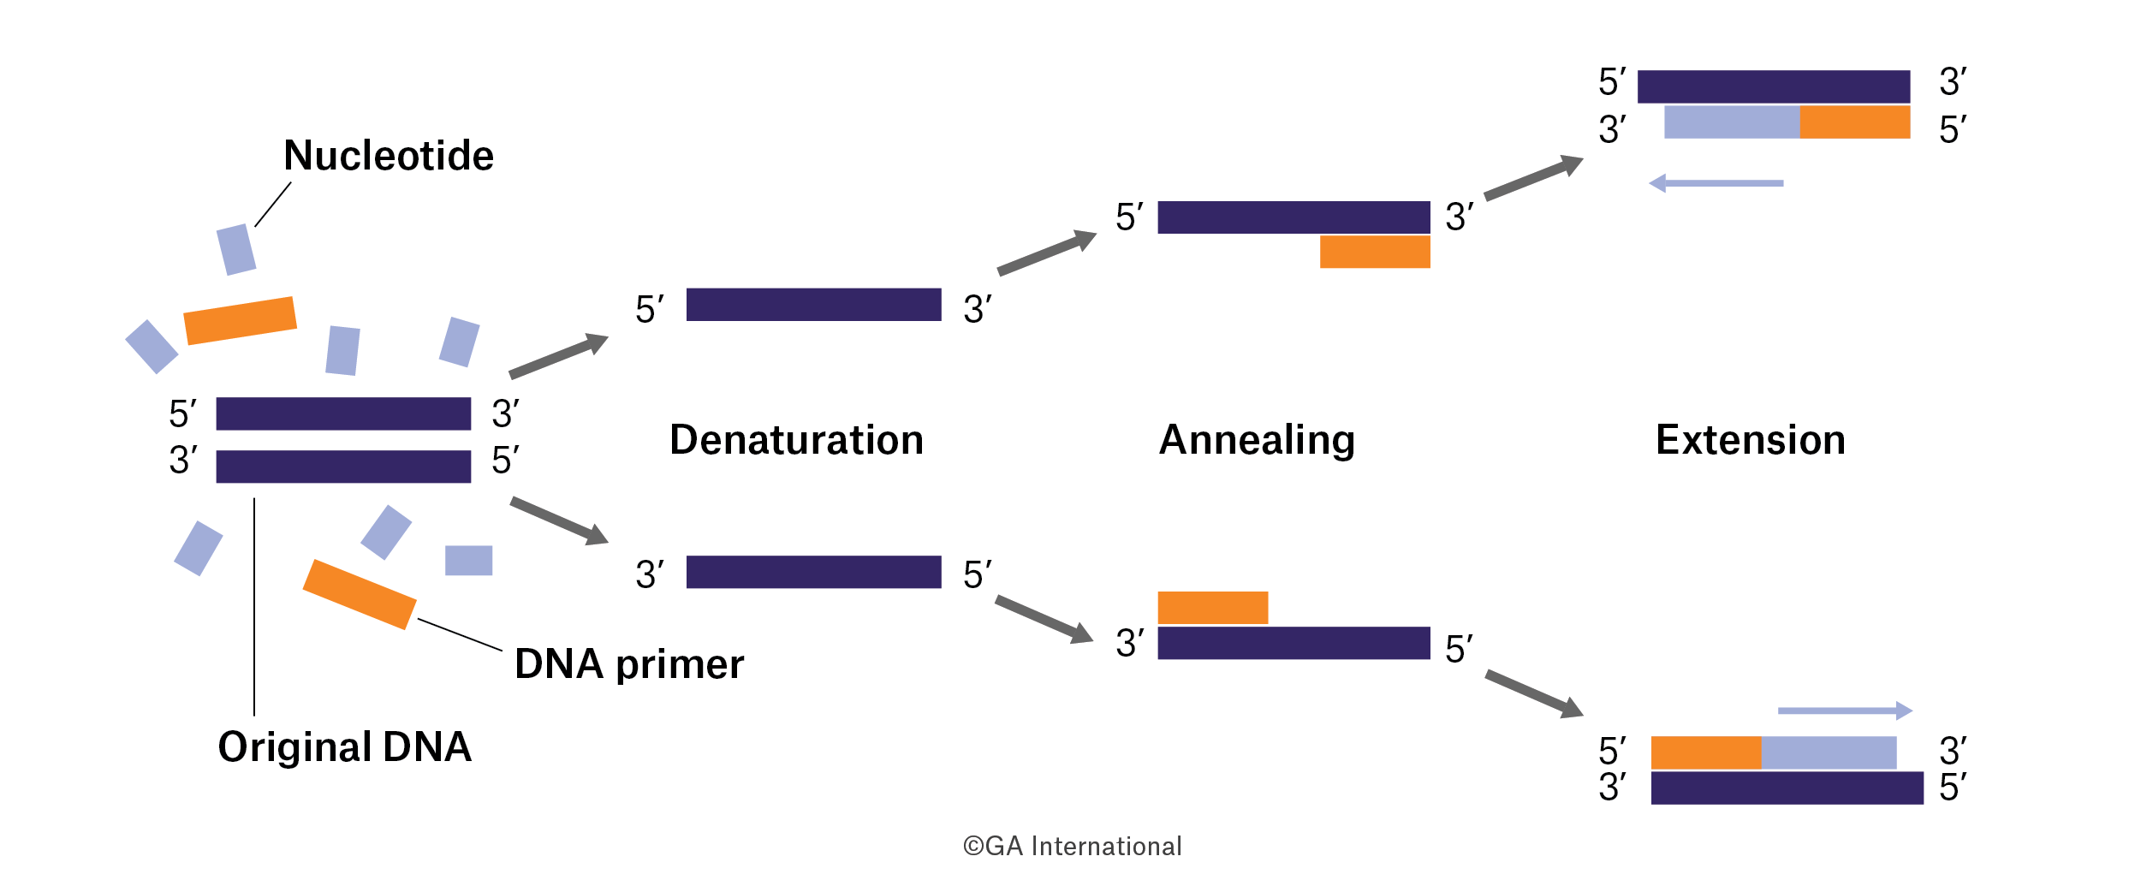
2) PCR Amplification
Goal: Selectively amplify the marker gene region to generate enough target DNA for sequencing
Input: Purified DNA + primers that bind to conserved regions
Output: Amplified amplicons (target genes/variable regions)
Notes:
Selectively copying the region we care about, instead of sequencing all the DNA
Without amplification, there wouldn’t be enough DNA for the sequencer to detect
PCR produces millions copies of each target region, making it measurable
Primer binds with the DNA template and generates new DNA strands.
We use primers that bind to conserved regions so we can amplify the variable regions that tell us about taxonomic differences.

Slide 11
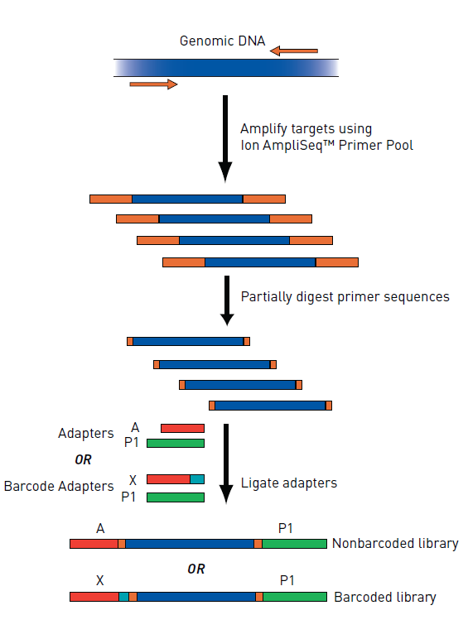
3) Library Preparation
Goal: Make PCR amplicons compatible with the sequencing platform and trackable across samples
Input: Amplified target region (PCR products)
Output: Sequencing-ready DNA fragments with adapters and indices pooled into a single library
Notes:
Library construction is like putting shipping labels (adapters) and barcodes (indices) on identical boxes (amplicons), so the sequencing machine knows how to “scan” them and later you can tell which box came from which sender.
This step adds adapters and barcodes so we can pool samples together for sequencing.

Slide 12
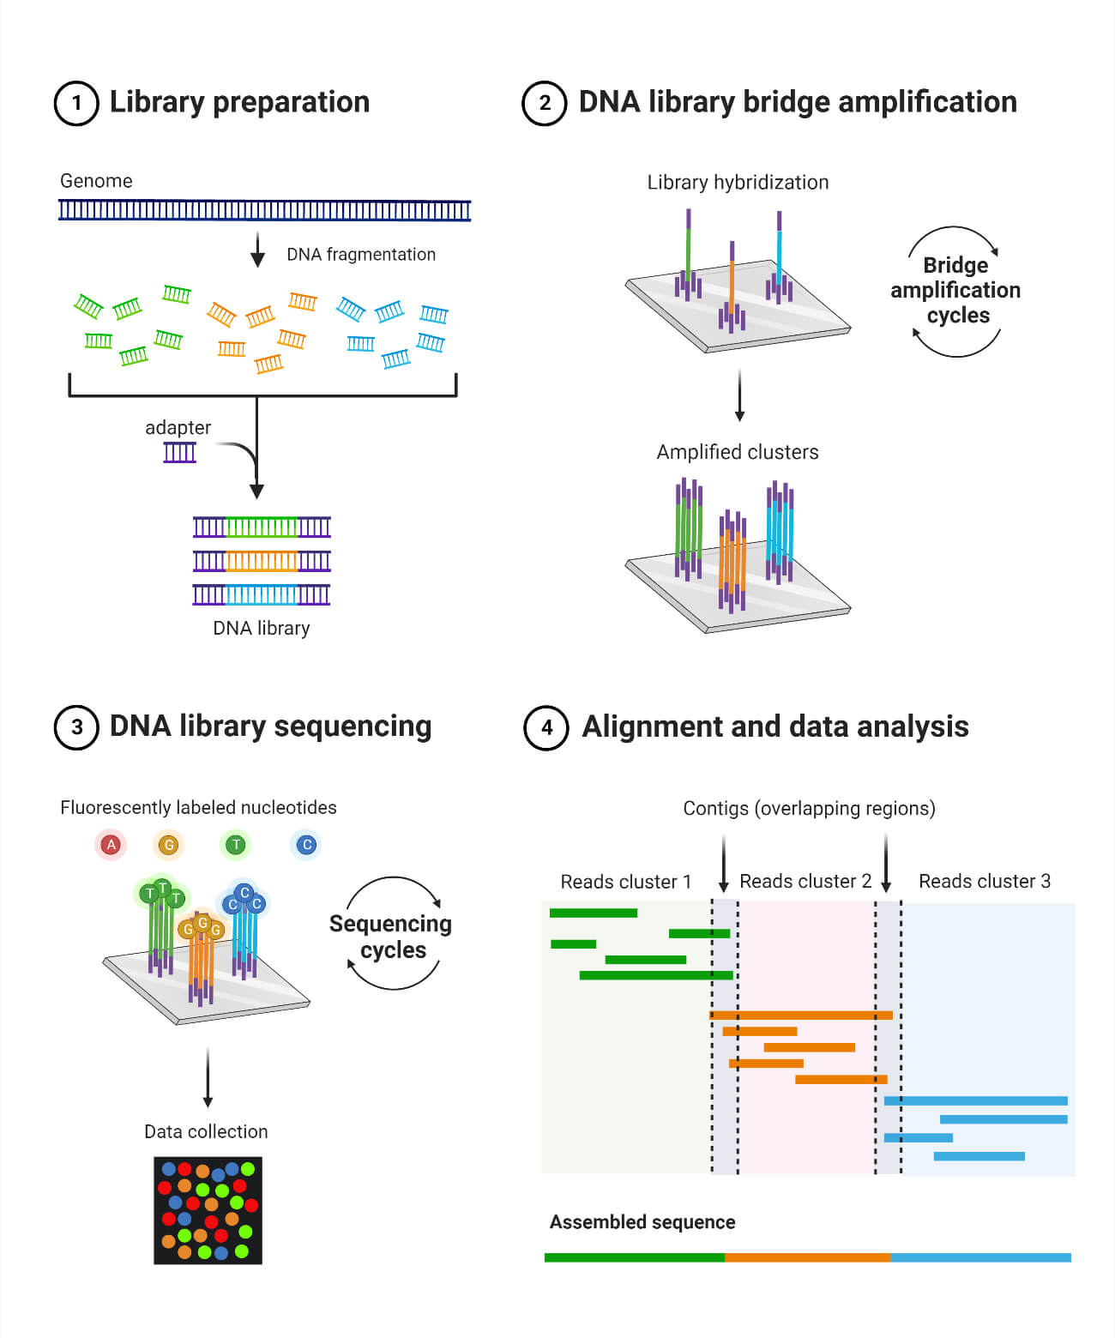
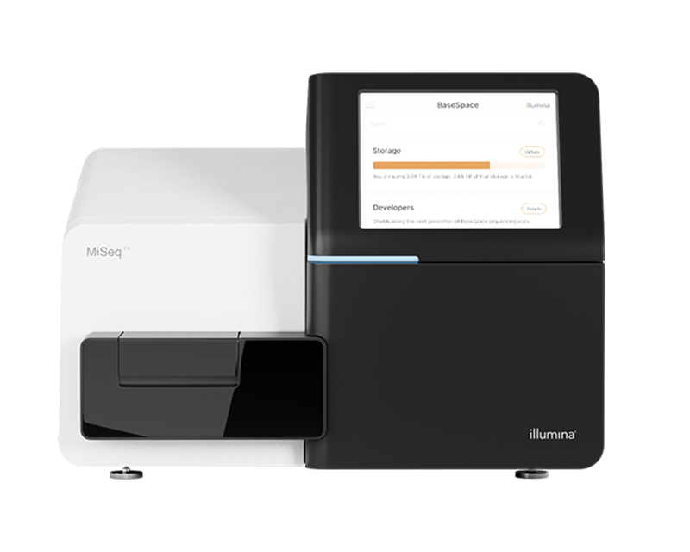
4) Sequencing
Goal: Determine the nucleotide sequences of the PCR-amplified regions
Input: Sequencing-ready DNA library
Output: FASTQ files containing sequences and quality scores
Notes:
After library preparation, bridge amplification happens where each bound DNA molecule is amplified in place to form a cluster of identical DNA copies – this ensures a strong fluorescent signal to be detecting
The sequencer adds fluorescently labeled nucleotides and generates a sequence read
Sequencer converts fluorescent signals into letters
Gives quality scores indicating confidence in each base
Most amplicon sequencing is done on Illumina platforms, producing FASTQ files with sequences and quality scores

Slide 13
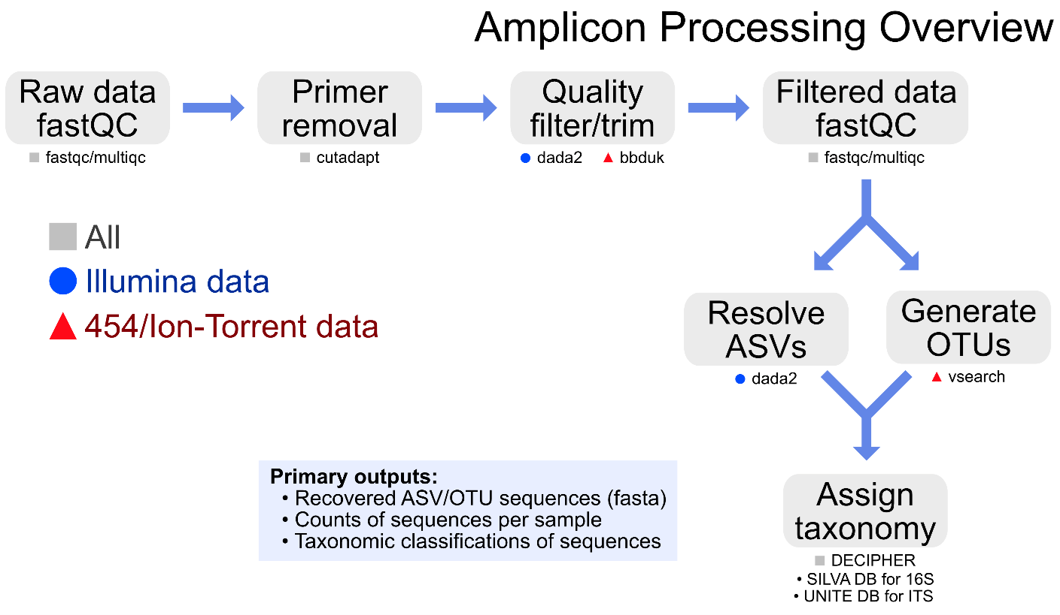
5) Bioinformatics
Goal: Process raw sequencing data to identify real biological variants and assign taxonomy
Input: FASTQ files from sequencer
Output: ASV table showing samples, taxa, and abundances

Slide 14

DADA2 (Divisive Amplicon Denoising Algorithm)
Filter & trim: remove poor-quality bases/reads.
Dereplicate: collapse identical reads, speed up processing.
Learn error rates: build error model from data.
Infer ASVs: distinguish real biological variants from sequencing errors.
Merge paired reads: forward + reverse overlap to form full amplicon.
Remove chimeras: get rid of PCR artifacts.
Assign taxonomy: classify ASVs with reference databases:
16S → SILVA, Greengenes2, RDP
ITS → UNITE
Notes:
https://doi.org/10.1038/nmeth.3869
https://github.com/benjjneb/dada2
DADA2 is a popular pipeline for processing amplicon sequencing data. It filters and trims reads, removes sequencing errors, merges paired reads, and outputs a table of amplicon sequence variants — or ASVs. These are more precise than traditional OTUs.

Slide 15
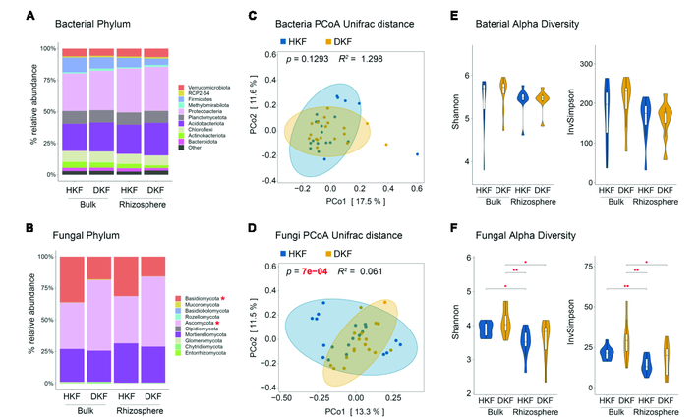
What to do with your ASV table?
Taxonomic profiles
Diversity metrics
Community comparisons
Predictive functional analysis

Slide 16
Predictive Functional Analysis
Amplicon sequencing identifies who is present, but not their exact genes
Using taxonomic information, we can predict potential functions and infer which genes may be active
PICRUSt → https://picrust.github.io/picrust/
FUNGuild → https://github.com/UMNFuN/FUNGuild

Slide 17
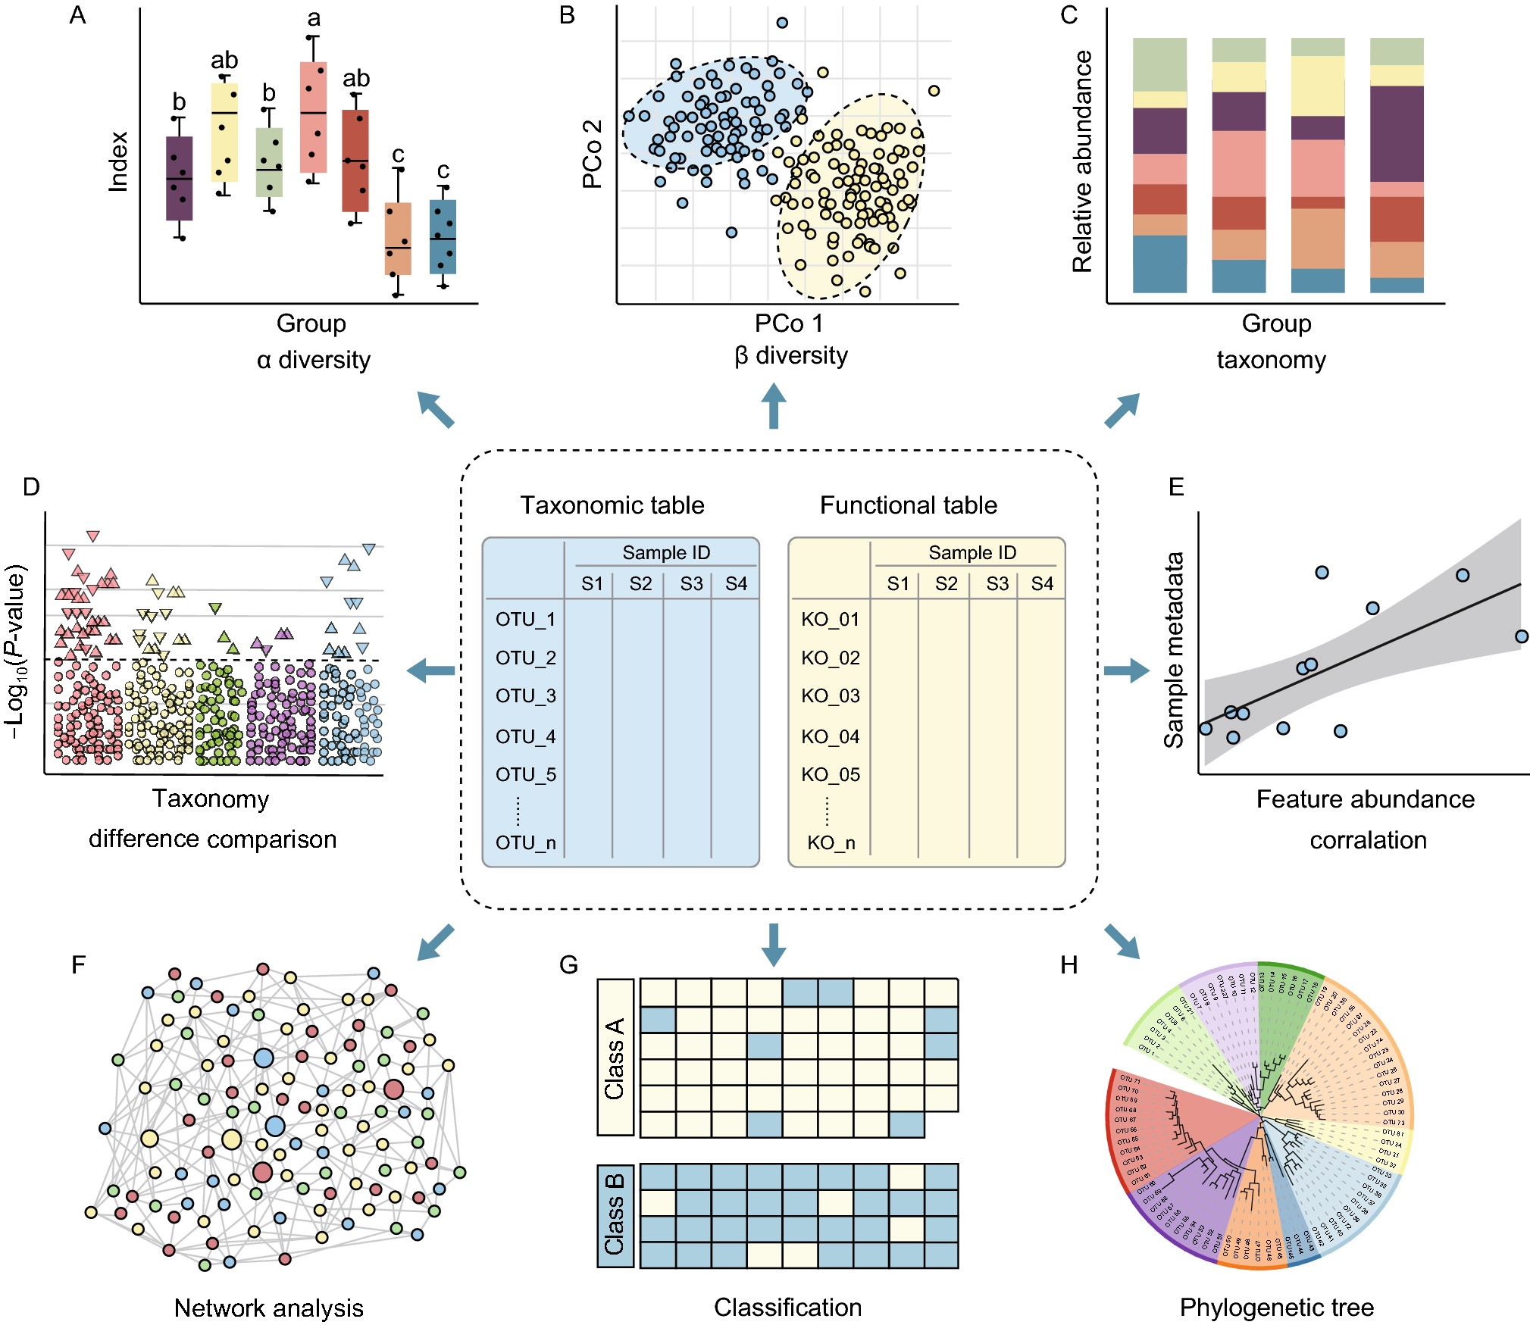
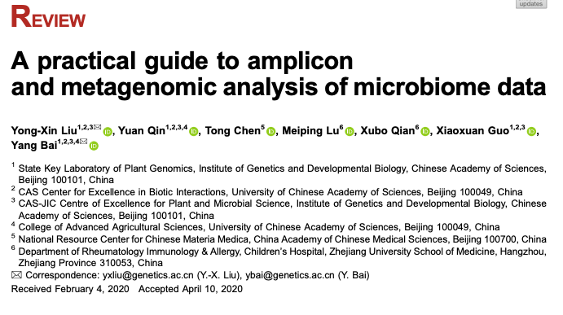
Statistical and visualization methods for feature tables
Notes:
https://doi.org/10.1007/s13238-020-00724-8

Slide 18
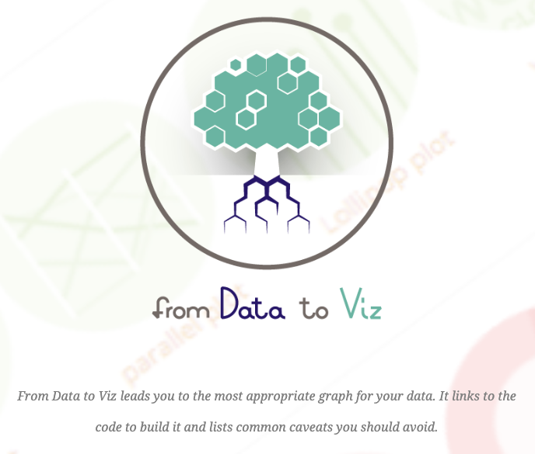

Other Helpful Resources
https://www.data-to-viz.com/
https://moderndive.com/index.html

Slide 19
What we will be doing today
Taxonomic composition and abundance for 16S and ITS data using the DADA2 pipeline
Predictive functional analysis on ITS data using FUNGuild

Slide 20
References
Callahan, B., McMurdie, P., Rosen, M. et al. DADA2: High-resolution sample inference from Illumina amplicon data. Nat Methods 13, 581–583 (2016). https://doi.org/10.1038/nmeth.3869
Yong-Xin Liu, Yuan Qin, Tong Chen, Meiping Lu, Xubo Qian, Xiaoxuan Guo, Yang Bai, A practical guide to amplicon and metagenomic analysis of microbiome data, Protein & Cell, Volume 12, Issue 5, May 2021, Pages 315–330, https://doi.org/10.1007/s13238-020-00724-8
Knight, R., Vrbanac, A., Taylor, B.C. et al. Best practices for analysing microbiomes. Nat Rev Microbiol 16, 410–422 (2018). https://doi.org/10.1038/s41579-018-0029-9
Anuj Kumar Gupta, UD Gupta, Chapter 20 - Next generation sequencing and its applications, Editor(s): Ashish S. Verma, Anchal Singh, Animal Biotechnology (Second Edition), Academic Press, 2020, Pages 395-421, ISBN 9780128117101, https://doi.org/10.1016/B978-0-12-811710-1.00018-5

Slide 21
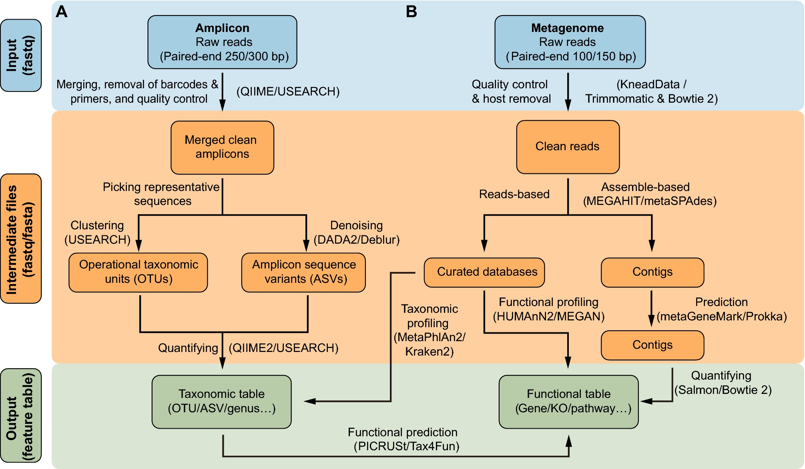
Processing Amplicon vs. Metagenome
Notes:
https://doi.org/10.1007/s13238-020-00724-8

Slide 22
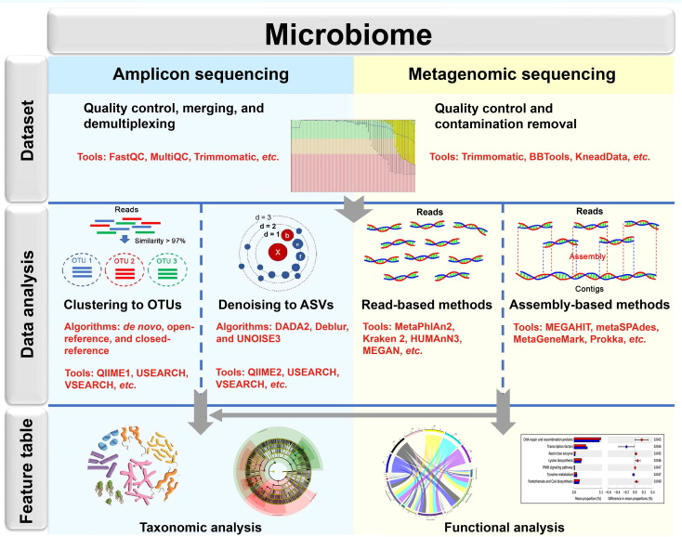
Notes:
https://doi.org/10.1016/B978-0-12-811710-1.00018-5

